Slide 1

GROCERY SHOPPING MADE EASY
Hyunsoo Kim
Ayesha Goonetilleke
Nicholas Menough
Notes:
Hi everyone. this presentation to share our vision for a Smart Grocery Shopping Assistant and how we aim to integrate online and in-store interactions.

Slide 2

Grocery shopping is becoming inconvenient.
PROBLEM SPACE
Too many grocery stores that are too large
No maps, guides, etc. other than a few signs to guide people around
Oftentimes, workers are too busy with their jobs to help others
Becoming healthier is in.
People are focused on meal planning to become more healthy
People have to create their own documents, watch YouTube videos, etc. to figure out how to meal prep
There is no way currently for people to create and shop their own meal plans in one application
People want to save money
Groceries are becoming increasingly more expensive
People want ways to make the meals they want for cheap
It’s difficult to create shopping lists at grocery stores when users can’t save their own lists
Notes:
Imagine starting your shopping journey at home, planning meals and selecting items with ease. Then, when you head to the store, the experience continues seamlessly, guided by real-time AR assistance that helps you navigate aisles and locate products effortlessly.
Our assistant offers powerful features to simplify decision-making:
- recipe suggestions for meal planning based on diet.
- budgeting tools track spending trends.
with various features our goal is to Reduce Mental Load
of grocery shopping, particularly for those with dietary restrictions. It integrates budget and health goals directly into the process, making shopping more intuitive and less stressful.

Slide 3


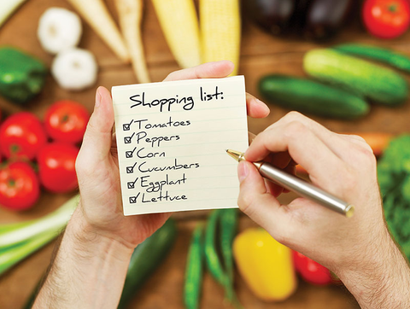

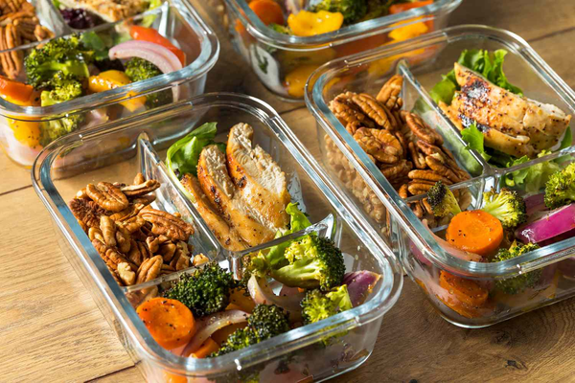

PRE-SHOPPING: PLANNING & PREPARATION
SYSTEM THINKING
Behavioral Goals: Reduce mental load, improve planning efficiency, and align purchases with health, budget, and lifestyle needs.
Activities:
Meal Planning:
Selecting recipes based on dietary preferences and restrictions.
Planning meals for a specific timeframe (e.g., week or month).
Adjusting recipes for portion sizes or ingredient availability.
List Creation:
Generating shopping lists manually or using automation tools.
Adding frequently purchased items or recurring staples.
Categorizing items (e.g., by store aisle, priority, or meal).
Budgeting:
Setting a spending limit for the trip or timeframe.
Reviewing price comparisons across stores or brands.
Research & Discovery:
Searching for sales, discounts, and promotions.
Filtering products for dietary compatibility (e.g., gluten-free, vegan).
Discovering new products or recipes.
Phases of the grocery shopping journey:
Notes:
Lets look at grocery shopping behaviors and systems thinking,
Let’s start with the pre-shopping phase. The main goals here are to reduce mental load, improve planning efficiency, and align purchases with health, budget, and lifestyle needs.
Key activities include meal planning, creating shopping lists, and budgeting.
This involves selecting recipes, planning meals, adjusting portion sizes, and categorizing items.
Budgeting tools can help set spending limits and compare prices across brands."

Slide 4

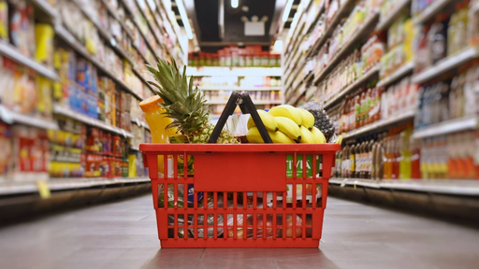
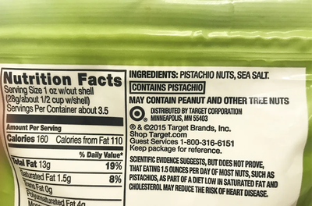
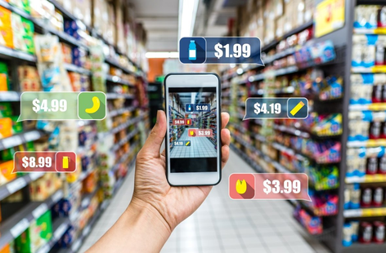
SHOPPING: IN-STORE OR ONLINE
SYSTEM THINKING
Behavioral Goals: Streamline the shopping process, locate items quickly, and make informed purchasing decisions.
Activities:
Navigating the Store:
Using real-time maps or AR overlays to locate products.
Following optimized routes to minimize time spent in-store.
Searching for substitute products if an item is out of stock.
Making Purchases:
Scanning items in-store for real-time pricing, dietary compatibility, or budget adherence.
Comparing products based on price, reviews, or nutritional value.
Adjusting the shopping list dynamically (e.g., adding forgotten items, removing duplicates).
Engaging with Technology:
Leveraging in-store kiosks, mobile apps, or wearable devices for guidance.
Integrating loyalty cards or payment options for seamless checkout.
Managing Preferences:
Reviewing product labels for allergens or health benefits.
Avoiding impulse purchases with AI-generated recommendations.
Evaluating alternatives suggested by dietary filters or budget constraints.
Phases of the grocery shopping journey:
Notes:
Moving on to the shopping phase, whether it’s in-store or online, the goals are to streamline the process, locate items efficiently, and make informed decisions.
Activities include navigating the store, making purchases, and engaging with technology.
Real-time maps, AR overlays, and loyalty card integrations are tools that make this phase smoother.
Additionally, managing preferences—like reviewing product labels or avoiding impulse purchases—plays a key role.

Slide 5

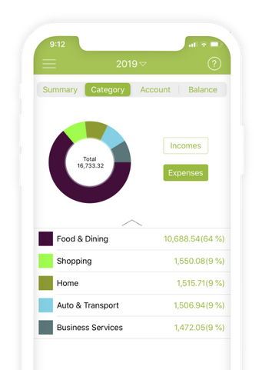
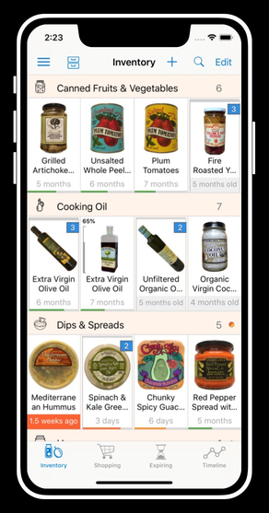
POST-SHOPPING: USAGE & INSIGHTS
SYSTEM THINKING
Behavioral Goals: Reflect on spending habits, reduce waste, and enhance future shopping trips.
Activities:
Budget Tracking:
Reviewing expenses via the app or digital receipts.
Identifying overspending or savings opportunities.
Consumption Tracking:
Logging consumed or unused items to minimize waste.
Analyzing trends in grocery consumption (e.g., popular meals, unused ingredients).
Feedback & Recommendations:
Rating products or leaving reviews.
Receiving personalized recommendations for future trips.
Inventory Management:
Syncing shopping lists with pantry inventory.
Setting reminders for restocking staple items.
Meal Preparation:
Following recipes linked to the purchased items.
Exploring new recipes using leftover ingredients.
Phases of the grocery shopping journey:
Notes:
In the post-shopping phase, the focus shifts to reflecting on habits, reducing waste, and improving future trips.
Activities include tracking budgets and consumption, managing inventory, and preparing meals.
Features like syncing lists with pantry inventory and using leftovers creatively help optimize this stage.

Slide 6

USER TYPES
SYSTEM THINKING
Goals:
Minimize time spent planning and shopping.
Find quick, healthy meal solutions for weekdays.
Stick to a budget due to busy work-life balance.
Challenges:
Forgetting essential items due to rushed planning.
Impulse purchases leading to overspending.
Limited patience for navigating large stores.
Behaviors:
Prefers automated meal planning and list creation.
Leverages real-time navigation to shop quickly.
Uses budgeting tools to track spending.
THE BUSY PROFESSIONAL
Mid-career individual with a demanding schedule, limited time for grocery shopping, often single or living with a partner.
Notes:
Our shopping assistant is designed to cater to various user types. We identified 4 main personas, each with unique goals and challenges:
The Busy Professional: Needs quick solutions and minimal planning time.

Slide 7

USER TYPES
SYSTEM THINKING
Goals:
Adhere to dietary restrictions or health goals.
Discover new, compatible products or recipes.
Avoid allergens or ingredients that conflict with their lifestyle.
Challenges:
Difficulty finding compliant products in-store.
Lack of clear nutritional information during shopping.
Overwhelmed by incompatible options and limited choices.
Behaviors:
Uses dietary filters and AI recommendations for healthier options.
Reviews product labels via an app for allergens.
Integrates meal planning with health apps or trackers.
THE HEALTH-CONSCIOUS SHOPPER
Individual or family-focused on specific dietary needs (e.g., vegan, gluten-free, low-carb).
Notes:
The Health-conscious Shopper: Prioritizes dietary compatibility and health goals.

Slide 8

USER TYPES
SYSTEM THINKING
Goals:
Maximize value for money without sacrificing quality.
Stay within a defined budget while shopping.
Find sales, discounts, and promotions.
Challenges:
Difficulty sticking to a budget when shopping in-store.
Lack of visibility into savings opportunities.
Struggling to manage frequent price fluctuations.
Behaviors:
Relies on budget filters and real-time price comparisons.
Tracks expenses with app-integrated summaries.
Explores sales or promotions before and during shopping.
THE BUDGET-CONSCIOUS SHOPPER
Student, family caregiver, or individual managing a tight budget.
Notes:
The Budget-conscious Shopper: Focuses on maximizing value while sticking to a budget

Slide 9

USER TYPES
SYSTEM THINKING
Goals:
Shop efficiently to cater to diverse family needs.
Balance nutritional priorities with children’s preferences.
Avoid stress during grocery shopping trips.
Challenges:
Juggling multiple lists for different family members.
Managing distractions while shopping with kids.
Ensuring purchases align with meal planning and dietary needs.
Behaviors:
Prefers personalized list creation based on family preferences.
Uses in-store navigation to quickly locate items.
Incorporates dietary filters for specific family members.
THE TIME-STRAPPED PARENT
Parent managing the grocery needs of a family, often with young children.
Notes:
The Time-strapped Parent: Balances family needs with efficiency and nutrition.

Slide 10
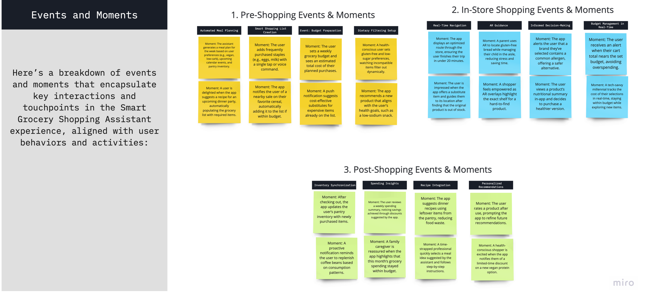
SYSTEM THINKING

Slide 11
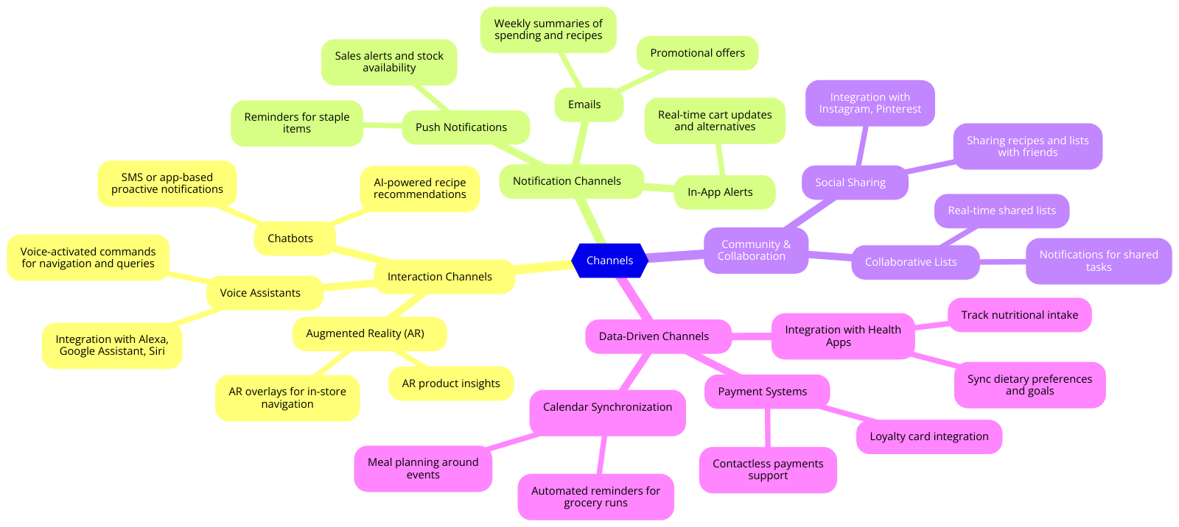
SYSTEM THINKING
Notes:
First, we have Interaction Channels, which focus on user engagement:
Voice Assistants: Users can plan groceries hands-free with Alexa, Google Assistant, or Siri, and use voice commands for in-store navigation and queries.
Chatbots: AI-powered chatbots provide recipe recommendations, troubleshooting, and proactive notifications like sale alerts.
Augmented Reality (AR): AR enhances in-store experiences by guiding users to products and displaying insights such as dietary information or alternatives.
Notification Channels Next, Notification Channels keep users informed.
Push Notifications:
In-App Alerts:
Community & Collaboration Channels, which promote sharing and teamwork:For exmaple the user type parent can use these channels with their family members.
Lastly, Data-Driven Channels leverage integrations to optimize user experience.
Health Apps: Sync with MyFitnessPal or Fitbit to align dietary goals and track nutritional intake.
Calendar Synchronization: Connect with Google Calendar to plan meals around events and schedule grocery trips.
Conclusion
these channels ensure that the Smart Grocery Shopping Assistant delivers a personalized and efficient experience tailored to the needs of every user.

Slide 12
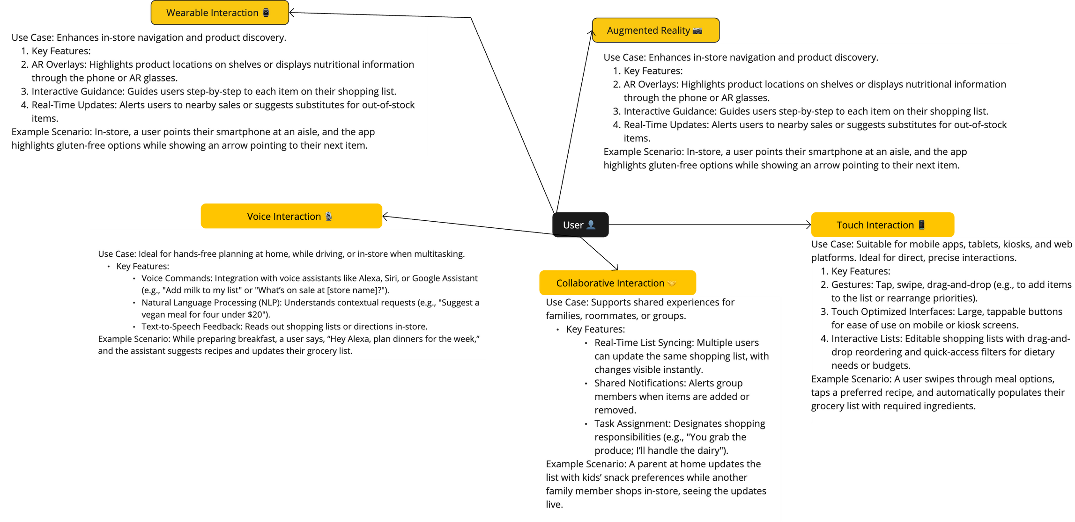
SYSTEM THINKING
Notes:
-interaction modalities designed for the Smart Grocery Shopping Assistant.
This way users can seamlessly interact with the assistant across different different technologies.
-, voice interaction is perfect for hands-free tasks at home, on the go, or in-store.
-AR interaction enhances in-store navigation and product discovery.
-Wearable interaction provides quick, on-the-go updates via smart watches.

Slide 13








HOME SCREEN
The main entry point with quick access to key features.
MEAL PLANNER
SITE MAP
Plan weekly meals with recipes and add ingredients to the shopping list.
SHOPPING LIST
View and manage items, including AI-suggested essentials.
STORE NAVIGATION
AR-powered feature to locate items in-store.
DEALS & OFFERS
Personalized offers based on shopping habits.
PROFILE & PREFERENCES:
User settings and customization options.
Notes:
Our site map is carefully designed to streamline navigation and enhance usability. Starting from the Home Screen, users have immediate access to essential features like the Meal Planner, Shopping List, Store Navigation with AR, Deals & Offers, and Profile & Preferences settings.
Each main screen has submenus that dive deeper into functionality. For example, in the Meal Planner, users can view weekly meal plans, search for recipes, or access saved meals. In Deals & Offers, they can browse by aisle or recipe, and access personalized promotions. This structure allows us to deliver a rich, customized experience that caters to diverse user needs, making SmartCart not just a shopping app but a personal assistant for grocery management

Slide 14
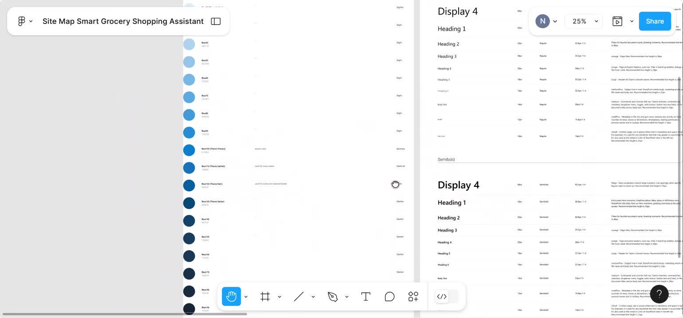
Component Nomenclature & Architecture
Atomic Design: Atoms, Molecules, Organisms, Templates, Pages.
Atoms: Basic elements (buttons, icons, text inputs).
Molecules: Functional groups (Search Bar, Recipe Card
Organisms: Complex components (Header, Shopping List).
Templates & Pages: Structured layouts and final interactive screens.
Notes:
To create a cohesive and scalable system, we adopted Atomic Design principles. Starting with Atoms—the simplest elements like buttons and icons—we built up to Molecules, which are functional components like our Search Bar or Recipe Card. These Molecules combine to form Organisms such as the Header or Shopping List, delivering core functionality to the user. Finally, Templates and Pages provide layout structures that make each screen consistent and user-friendly. This approach makes SmartCart scalable, adaptable, and easy to maintain."

Slide 15
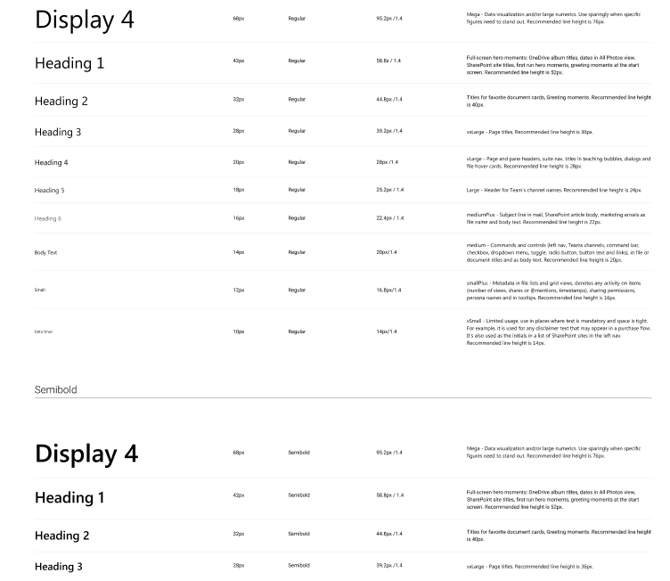
Color Theme & Typography
CREATING VISUAL CONSISTENCY WITH COLOR AND TYPOGRAPHY
PRIMARY COLOR (#0078D4): CONVEYS TRUST AND INNOVATIONTYPOGRAPHY
TYPOGRAPHY HIERARCHY:
DISPLAY 4 FOR LARGE TITLES.
HEADING 2 FOR SUBHEADINGS.
BODY TEXT FOR READABILITY.
CONSISTENT STYLING FOR A COHESIVE EXPERIENCE
Notes:
We chose a color theme that’s both modern and inviting. Our primary color is a calming blue that represents trust and innovation, giving SmartCart a professional yet friendly feel. For typography, we focused on clarity and readability. Larger fonts for major titles ensure that users immediately know what’s important, while smaller, consistent body text makes content easy to read. This cohesive styling guides users through the app, providing a smooth, visually pleasing experience.

Slide 16
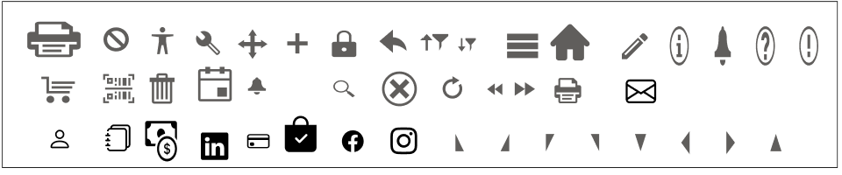
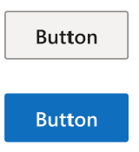
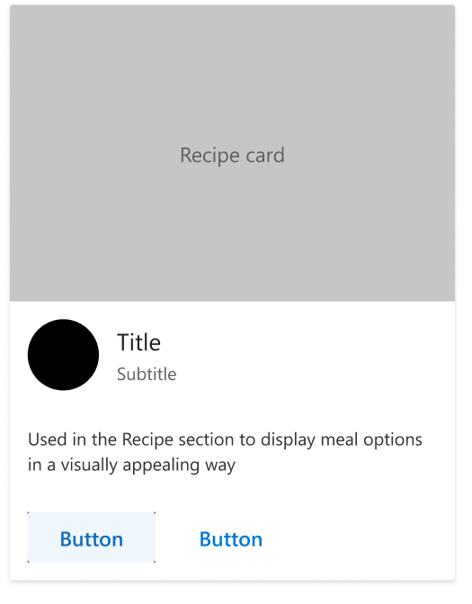

BUILDING BLOCKS - ATOMS & MOLECULES
Atoms: Smallest components used across screens.
Molecules: Functional groups of Atoms.
SEARCH BAR: COMBINES TEXT INPUT AND SEARCH ICON.
RECIPE CARD: CONTAINS IMAGE, TITLE, AND BUTTONS.
Notes:
Atoms and Molecules are the foundation of SmartCart. Atoms are the smallest components, like buttons and icons, used consistently across the app. These come together to form Molecules—functional elements like the Search Bar and Recipe Card, which help users interact with the app. By standardizing these elements, we ensure a consistent look and feel, making navigation more intuitive

Slide 17
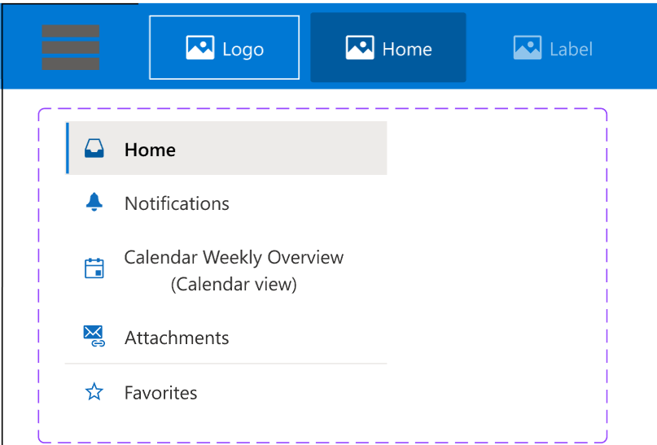
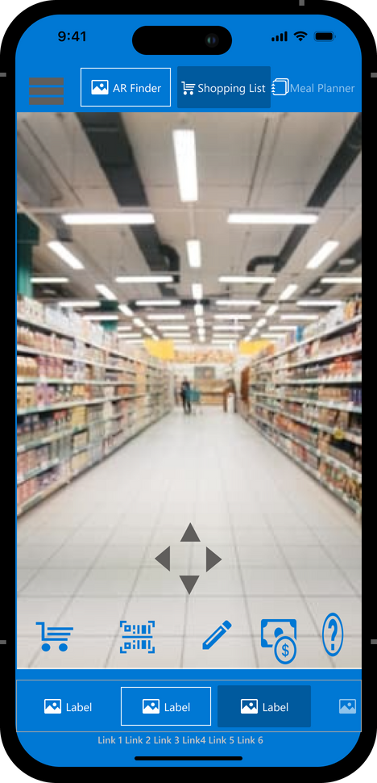
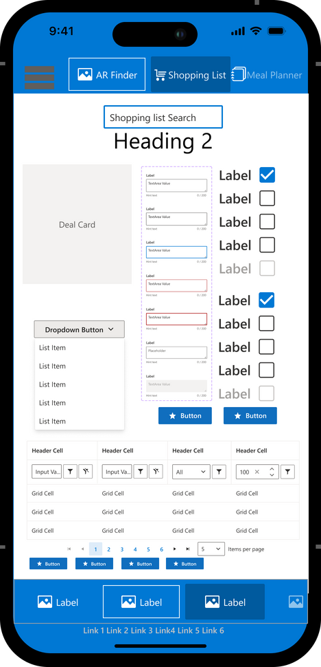
Organisms - Functional UI Components
Combine Molecules into complex sections
HEADER: LOGO, PROFILE ICON, NAVIGATION LINKS.
AR NAVIGATION OVERLAY: IN-STORE GUIDANCE.
SHOPPING LIST: CATEGORIZED ITEMS WITH CHECKBOXES.
Notes:
"Organisms bring together Molecules to create functional sections. Our Header combines navigation links, the logo, and the profile icon, making it easy for users to orient themselves. The Shopping List organizes items by category, with checkboxes for marking items off. Lastly, our AR Navigation Overlay uses real-time guidance to help users find items in-store. These Organisms create a seamless and practical experience, allowing users to move through the app with ease."

Slide 18
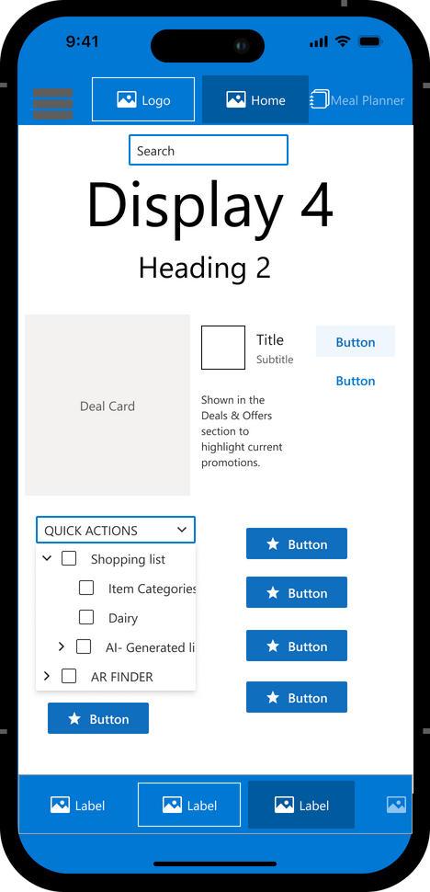
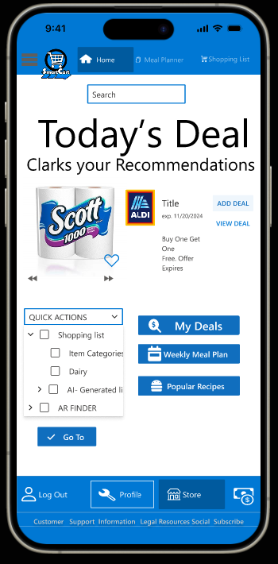
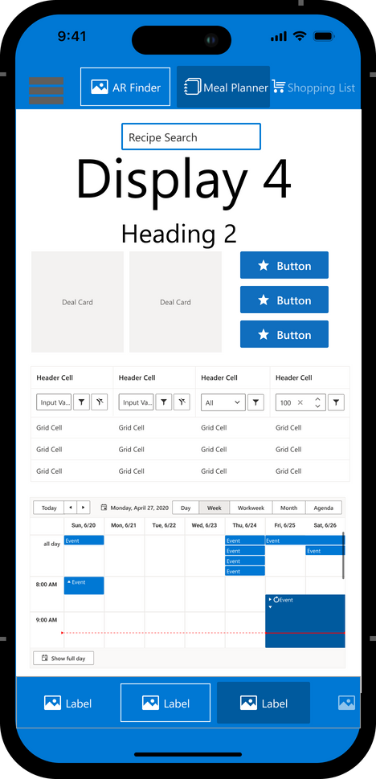
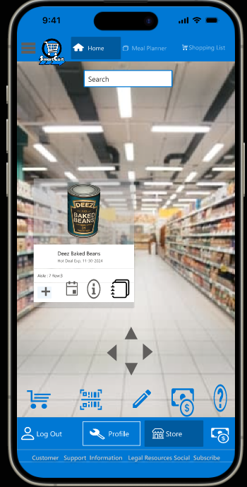
Templates: Predefined layouts for consistent structure.
Pages: Final interactive screens combining Templates and Organisms.
AR Navigation: Real-time in-store guidance integrated with the app experience.
Notes:
Templates are the backbone of SmartCart, providing a structured layout that helps users navigate each feature with ease. By starting with predefined Templates, we ensure that every screen feels familiar, organized, and intuitive. For instance, our Home Page Template arranges quick actions and personalized recommendations, allowing users to immediately access the most relevant information. In the Meal Planner Template, we offer a weekly view with interactive recipe cards, making it easy for users to plan their meals and add ingredients to their shopping list.
When we combine these Templates with Organisms like the Header, Shopping List, and Meal Planner, we create complete Pages—final interactive screens that users engage with. This approach to Templates and Pages ensures consistency across the app, helping users feel comfortable and in control as they move from planning meals to managing their shopping list.
But SmartCart goes beyond planning—it’s also designed to support users in-store with AR Navigation. Imagine walking into a grocery store, opening SmartCart, and being guided directly to each item on your list. The AR Navigation screen, as shown here, uses directional arrows and visual cues to lead users to specific products. The overlay displays aisle and row information, and users can also see important actions like adding items to their cart, viewing deals, or setting reminders—all within the AR view.
Why integrate AR with Templates and Pages? Together, these elements create a seamless user journey. Users plan their shopping in a structured, organized environment, and then, with AR Navigation, they carry that structured experience right into the store. This integration of Templates, Pages, and AR transforms SmartCart from a digital shopping assistant to a comprehensive, end-to-end shopping solution that supports users before, during, and after their trip to the store.

Slide 19

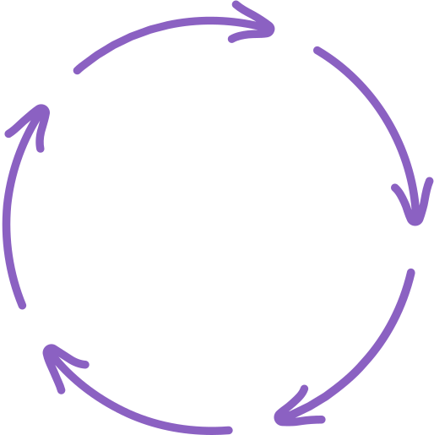




TECHNOLOGY CHOICES - MOBILE-FIRST WITH AI AND AR
FLUENT UI
REACT & FLUENT DESIGN: ENSURES CROSS-PLATFORM SUPPORT
AI INTEGRATION: PERSONALIZED RECOMMENDATIONS, SMART LISTS.
AR NAVIGATION: IN-STORE GUIDANCE FOR ITEM LOCATION.
MOBILE-FIRST: DESIGNED FOR ON-THE-GO USABILITY.
Notes:
SmartCart is built with cutting-edge technology, including React and Fluent Design for cross-platform support, making it seamless across iOS and Android. AI powers personalized recommendations, ensuring that users see relevant items and deals, while AR offers in-store navigation that makes finding items easier than ever. Being a mobile-first app, SmartCart is designed for on-the-go use, giving users a shopping companion right in their pocket.

Slide 20
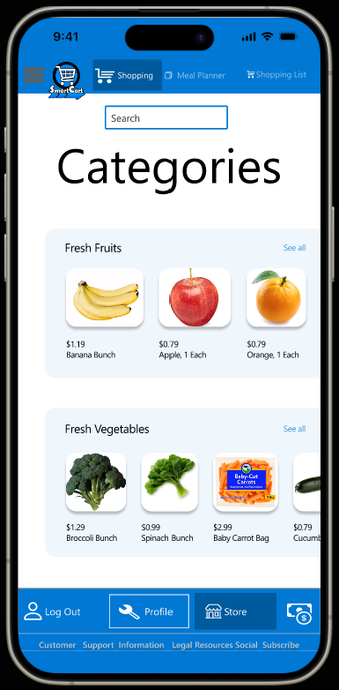
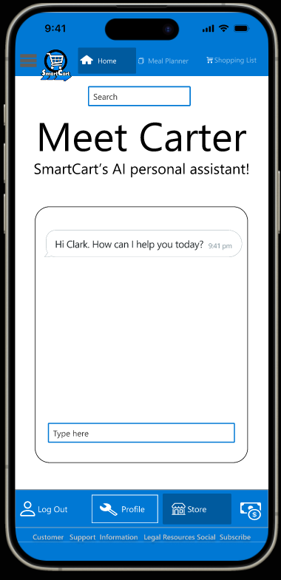
A COMPLETE GROCERY SHOPPING SOLUTION Visuals:
AR NAVIGATION: REAL-TIME GUIDANCE FOR AN EFFICIENT IN-STORE EXPERIENCE.
STRUCTURED DESIGN SYSTEM: FROM ATOMS TO PAGES, ENSURING CONSISTENCY AND SCALABILITY.
AI-POWERED PERSONALIZATION: TAILORED RECOMMENDATIONS AND SMART SHOPPING LISTS.
END-TO-END USER JOURNEY: SEAMLESS SUPPORT FROM PLANNING TO IN-STORE NAVIGATION.
Notes:
"In conclusion, SmartCart combines a structured design system with AI and AR technologies to redefine grocery shopping. Each component, from Atoms to Pages, plays a role in creating a seamless and intuitive user experience. With features like meal planning, shopping lists, and in-store navigation, SmartCart makes grocery shopping smarter, faster, and more enjoyable. Thank you, and I’m happy to answer any questions."

Slide 21
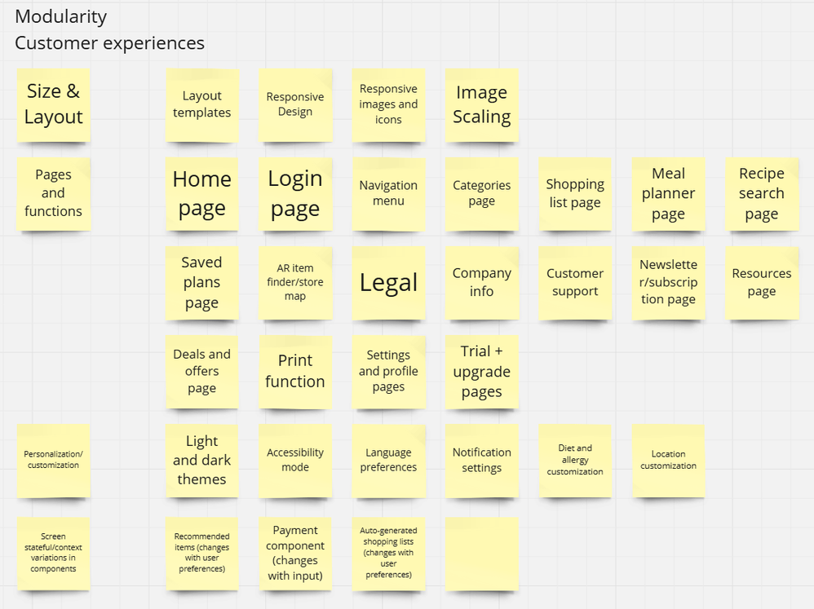
MODULARITY:
FOCUS ON CREATING A FLEXIBLE SIZE AND LAYOUT THAT CAN BE APPLIED ACROSS MULTIPLE DIFFERENT AREAS OF THE PRODUCT
SCREEN-STATEFUL COMPONENTS SUCH AS IN RECOMMENDED ITEMS ALLOW FOR MORE PERSONALIZATION AND CAN CHANGE DYNAMICALLY WITH WHAT THE USER PREFERS AT THE TIME

Slide 22
MODULARITY:
HEADER AND FOOTER ARE UNIVERSAL WHILE ALL OTHER PARTS ARE VARIABLE DEPENDING ON PURPOSE
SHOPPING LISTS, AR NAVIGATION, ETC. ARE ALSO CONTEXT-SPECIFIC

Slide 23
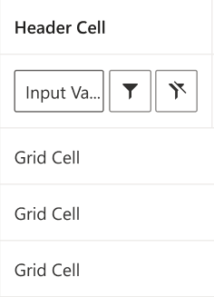
MODULARITY:
ORGANISMS ARE SIMPLE, JUST COMBINING MULTIPLE MOLECULAR-LEVEL DESIGNS

Slide 24
INNOVATIVE COMPONENTS:
AI ASSISTANT: THIS AI ASSISTANT WILL PROVIDE THE USER WITH A WAY FOR THEM TO GAIN NEW IDEAS AND CREATE THEIR OWN PLANS. AI ASSISTANT WILL ALSO GENERATE SHOPPING LISTS AND MEAL PLANS BASED ON USER PREFERENCES.
AR STORE MAP: APPLICATION WILL ALSO HAVE AN AR STORE MAP THAT ALLOWS USERS TO LOCATE AN ITEM IN REAL TIME OR TO JUST LOOK THROUGH THE STORE.

Slide 25
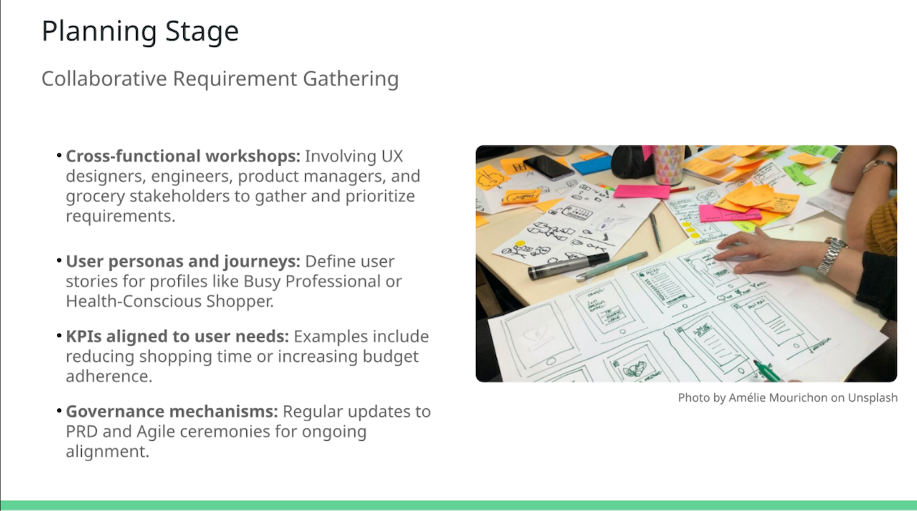
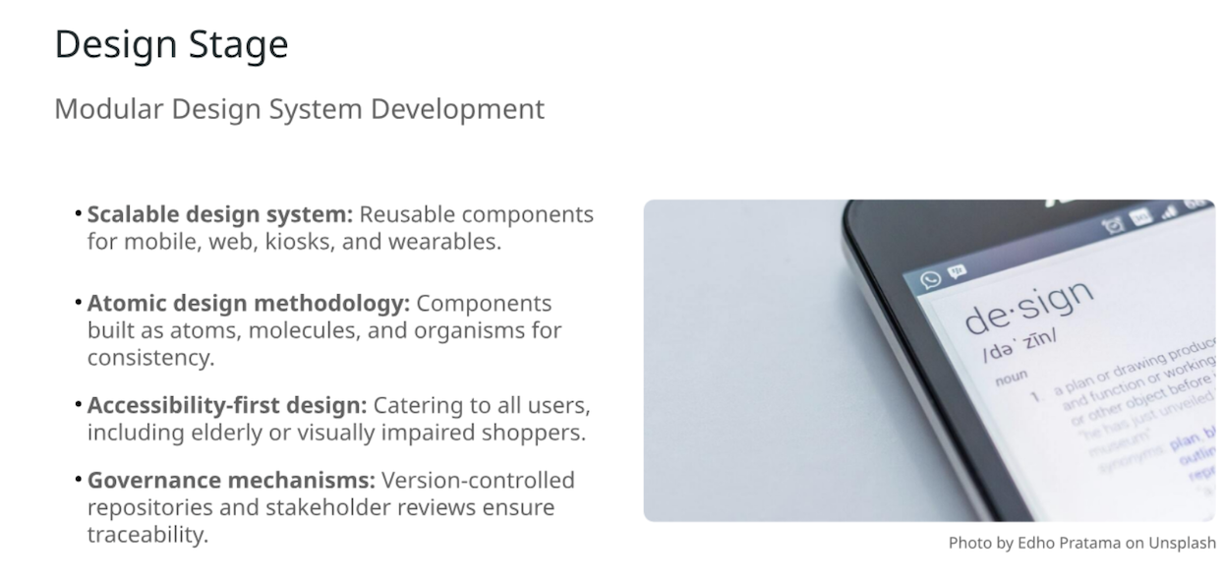
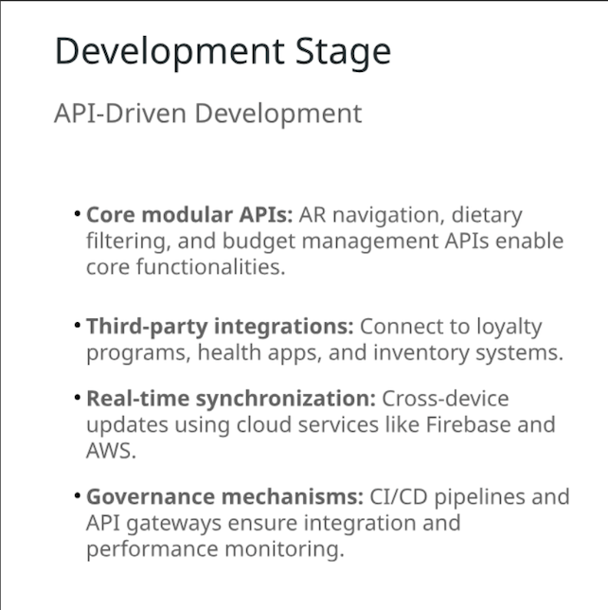
OPERATIONS

Slide 26

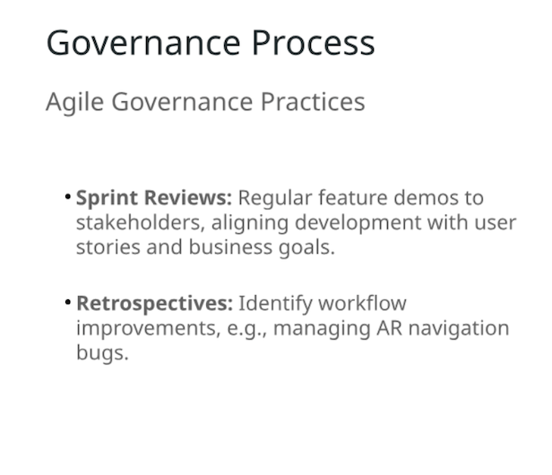
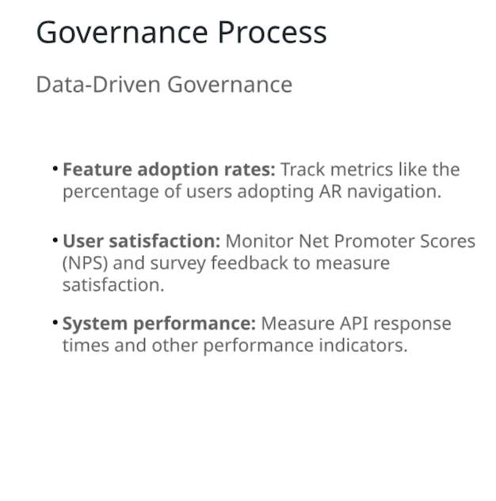
OPERATIONS

Slide 27
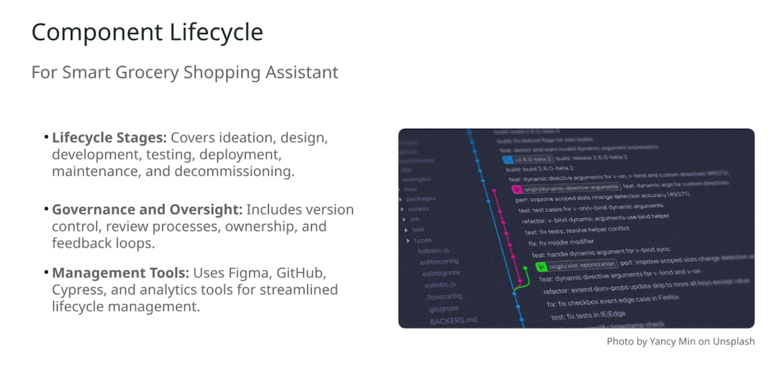
OPERATIONS

Slide 28

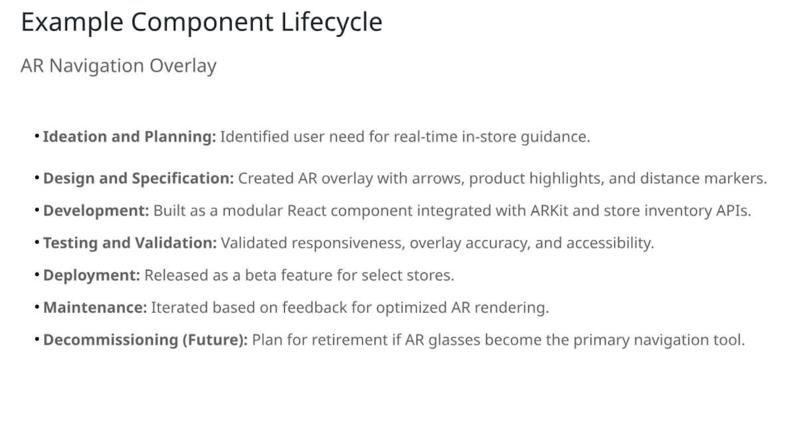
OPERATIONS

Slide 29
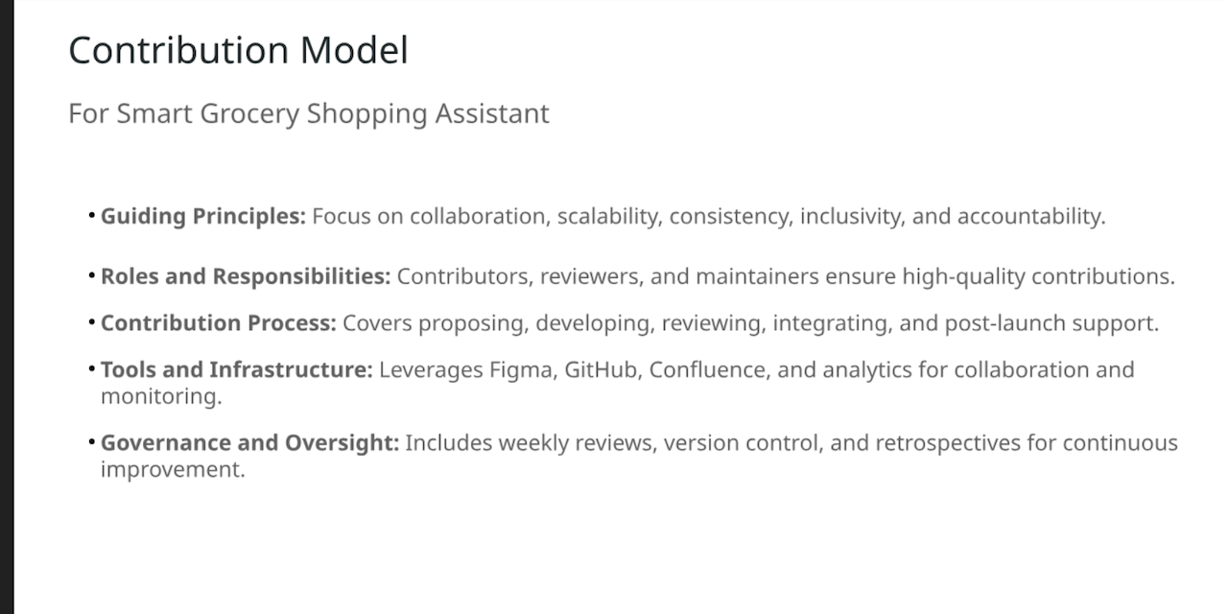
OPERATIONS

Slide 30
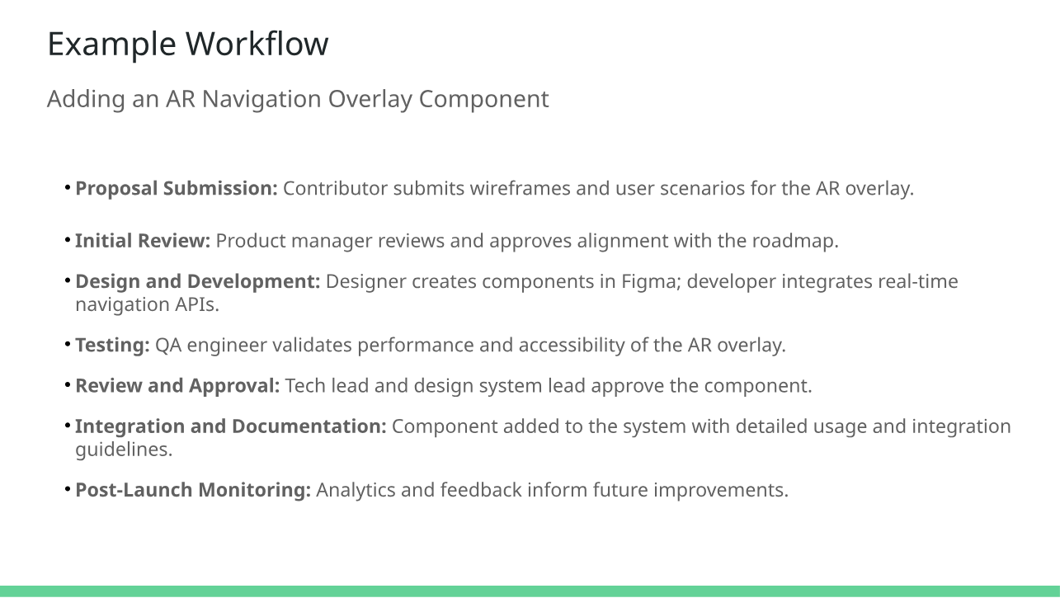
OPERATIONS

Slide 31
OPERATIONS

Slide 32
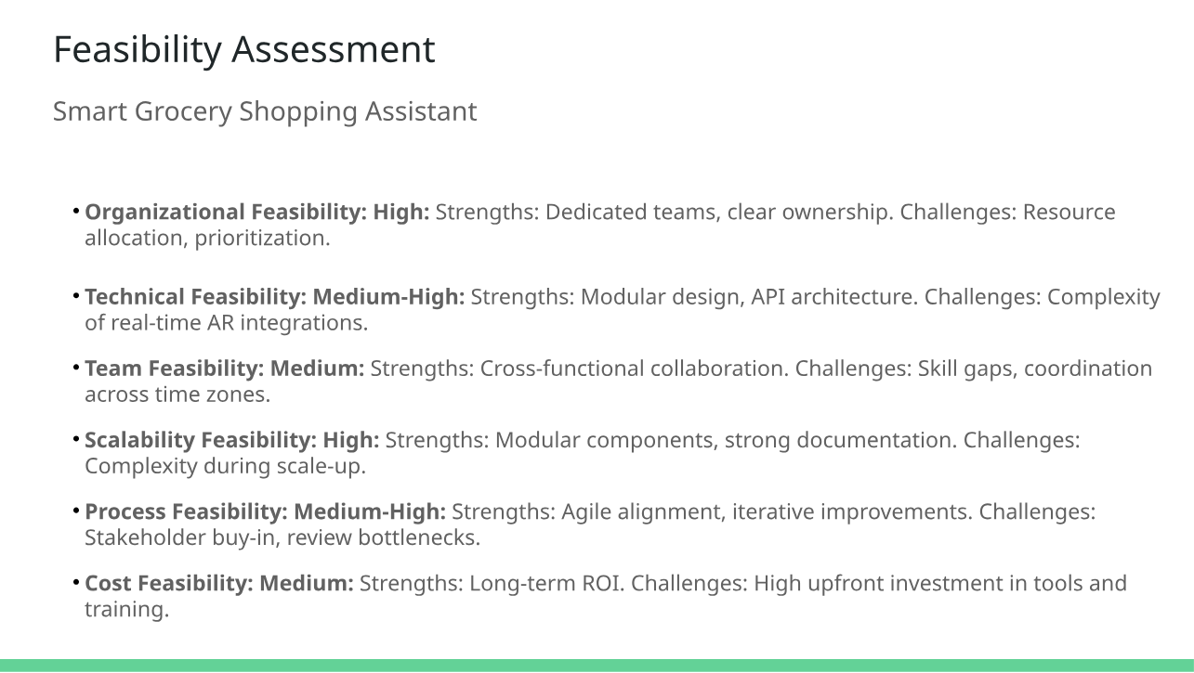
OPERATIONS

Slide 33

3,5 BILLION VIEW
Become a Star Members and Sellers
THANK YOU
Shop with Trust
Our mission is to provide a reliable online marketplace that can help you grow your business as well as finding the stuff you need.
Stuff based on categories

